Slide 1
Javascript-Behind the scence

Slide 2
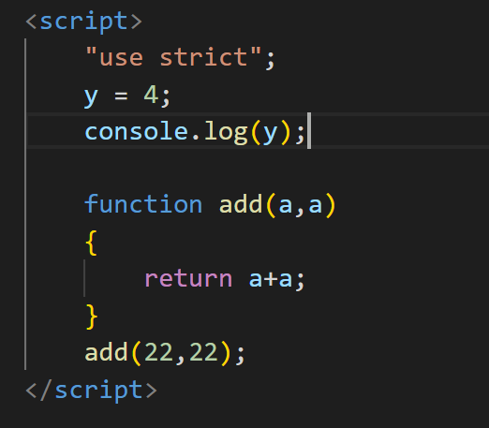
JavaScript strict mode
JavaScript is a loosely typed (dynamic) scripting language
JavaScript allows strictness of code using "use strict" with ECMAScript 5 or later.
Write "use strict" at the top of JavaScript code or in a function
"use strict";
var x = 1; // valid in strict mode
y = 1; // invalid in strict mode

Slide 3
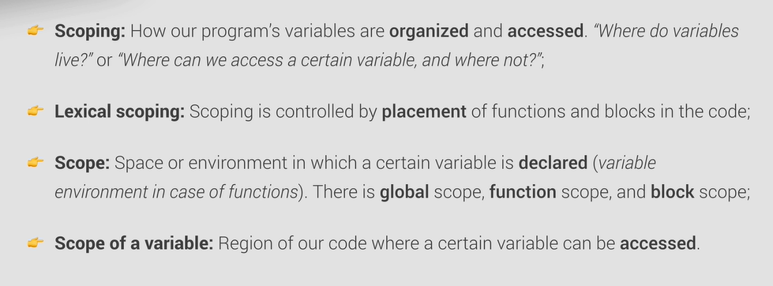
Scope Chain

Slide 4
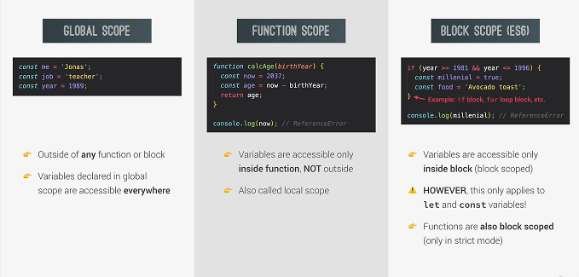
Types of Scope

Slide 5
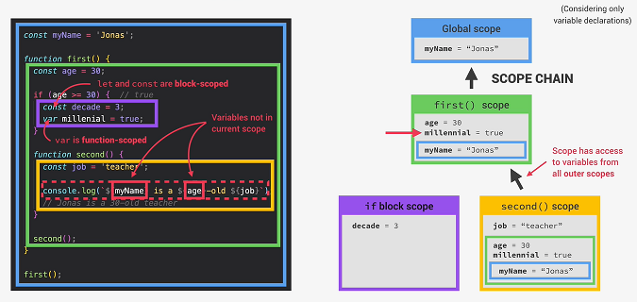
Scope Chain

Slide 6
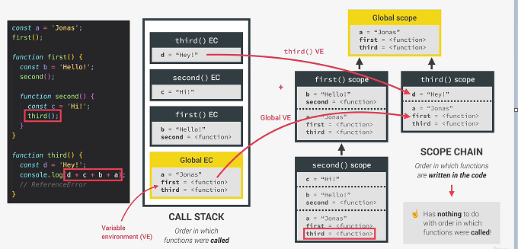
Scope Chain Vs Call Stack

Slide 7
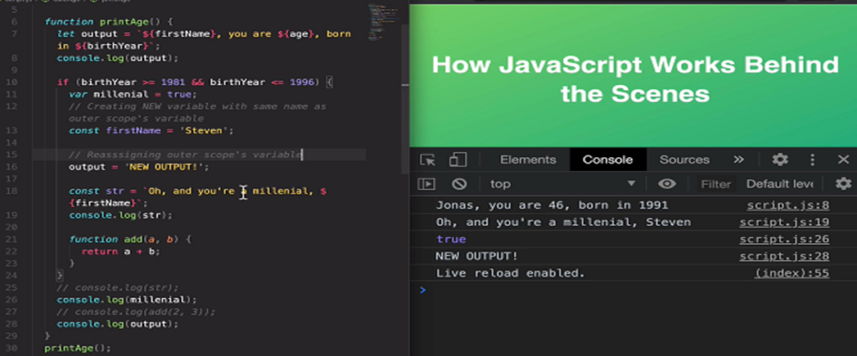
Scope Practice

Slide 8
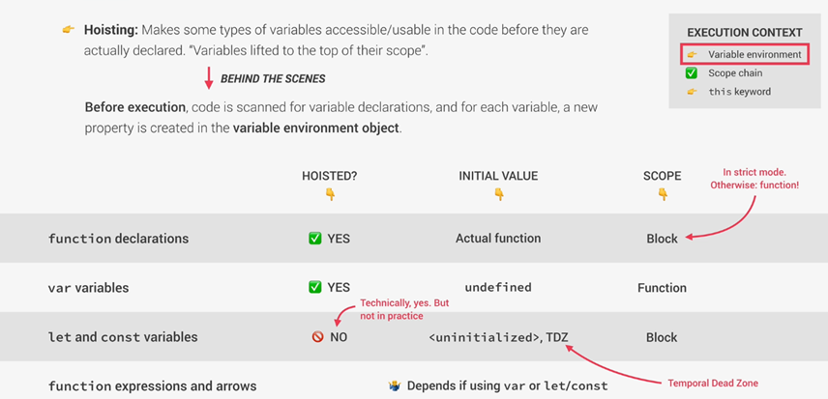
Hoisting

Slide 9
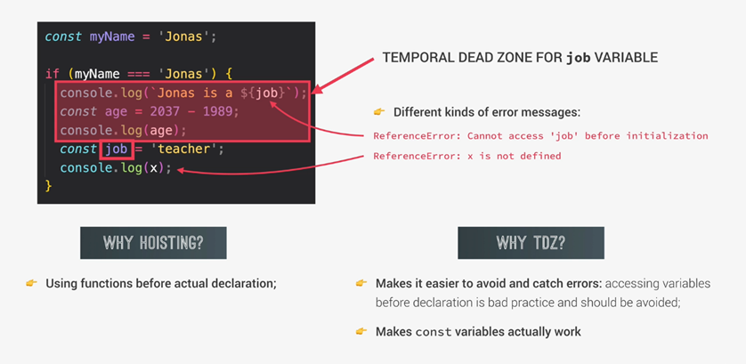
TDZ

Slide 10
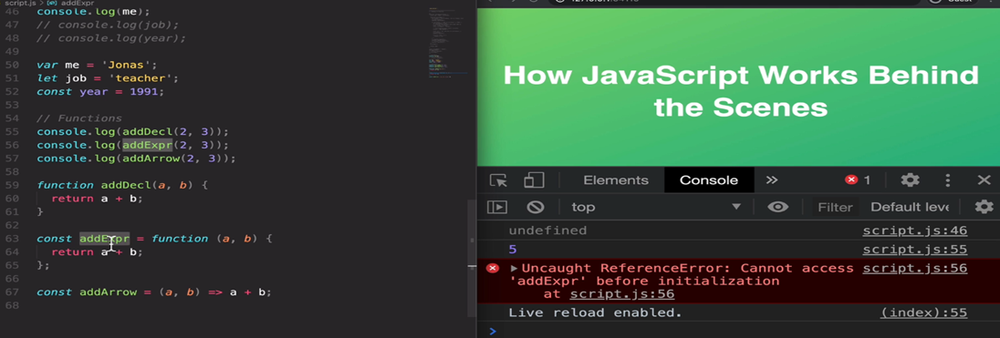
Hositing Practice

Slide 11
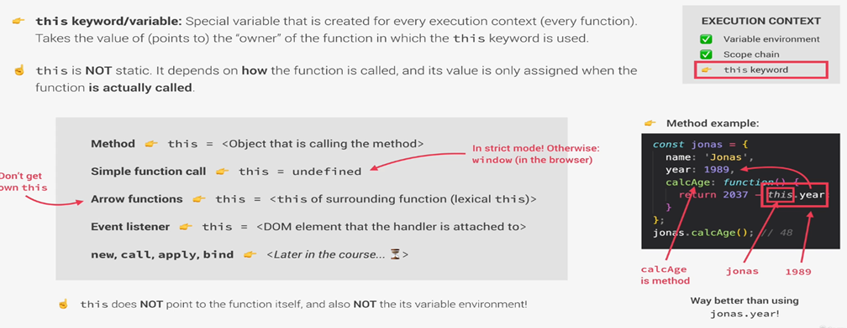
This keyword

Slide 12
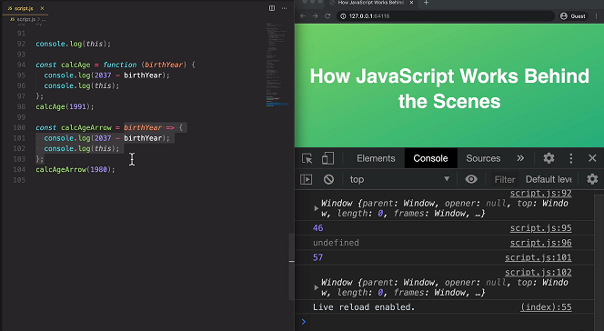
this keyword practice

Slide 13
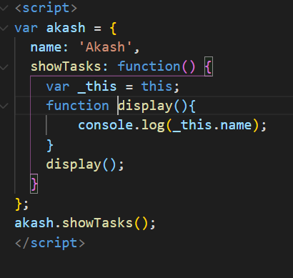
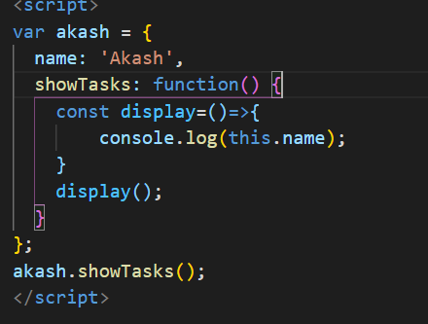
This keyword in normal function and arrow function

